Slide 1
PROGRAMMING ON AMAZON AWS
Amazon offers Simple Queue Service (SQS) & Simple Notification Service (SNS).
Auto-scaling enables you to automatically scale your Amazon EC2 capacity up or down according to conditions that you define.
With autoscaling, you can ensure that the number of Amazon EC2 instances you’re using scales up seamlessly during demand spikes to maintain performance, and scales down automatically during demand lulls to minimize cost.
Elastic load balancing automatically distributes incoming application traffic across multiple Amazon EC2 instances.
Both auto-scaling and elastic load balancing are enabled by CloudWatch.
CloudWatch is a web service that provides monitoring for AWS cloud resources, starting with Amazon EC2.
It provides customers with visibility into resource utilization, operational performance, and overall demand patterns—including metrics such as CPU utilization, disk reads and writes, and network traffic.

Slide 2
PROGRAMMING ON AMAZON EC2
Amazon was the first company to introduce VMs in application hosting.
Customers can rent VMs instead of physical machines to run their own applications.
By using VMs, customers can load any software of their choice.
The elastic feature of such a service is that a customer can create, launch, and terminate server instances as needed, paying by the hour for active servers.
Amazon provides several types of preinstalled VMs.
Instances are often called Amazon Machine Images (AMIs) which are preconfigured with operating systems based on Linux or Windows, and additional software.

Slide 3
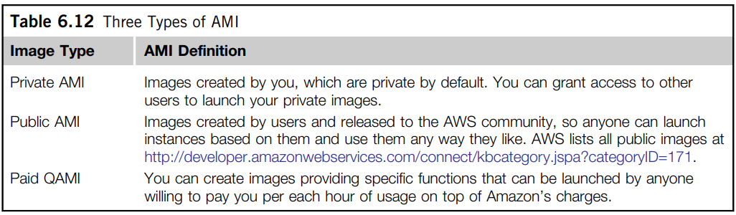
Table 6.12 defines three types of AMI.
AMIs are the templates for instances, which are running VMs.
Figure 6.23 shows an execution environment. This sequence is supported by public, private, and paid AMIs.
The workflow to create a VM is
Create an AMI → Create Key Pair → Configure Firewall → Launch
AMIs are formed from virtualized compute, storage & server resources shown at the bottom of Figure 6.23.

Slide 4
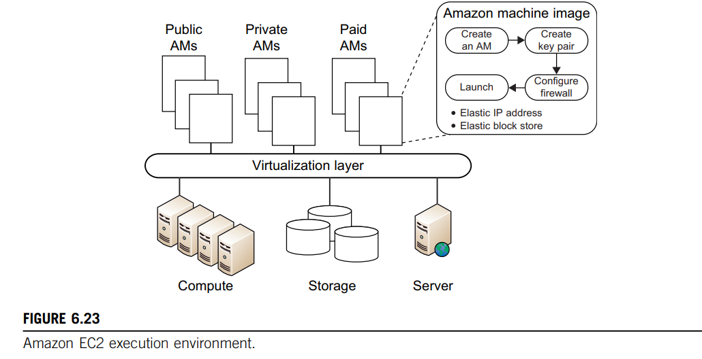

Slide 5
Ex: Use of EC2 Services in the AWS Platform
Table 6.13 defines the IaaS instances available in October 2010 in five broad classes:
Standard instances - well suited for most applications.
Micro instances - provide a small number of consistent CPU resources and allow you to burst CPU capacity when additional cycles are available - well suited for lower throughput applications & web sites - that consume significant compute cycles periodically.
High-memory instances - offer large memory sizes for high-throughput applications, including database and memory caching applications.
High-CPU instances - have proportionally more CPU resources than memory (RAM) - well suited for compute-intensive applications.
Cluster compute instances - provide proportionally high CPU resources with increased network performance - well suited for high-performance computing (HPC) applications & other demanding network-bound applications.

Slide 6
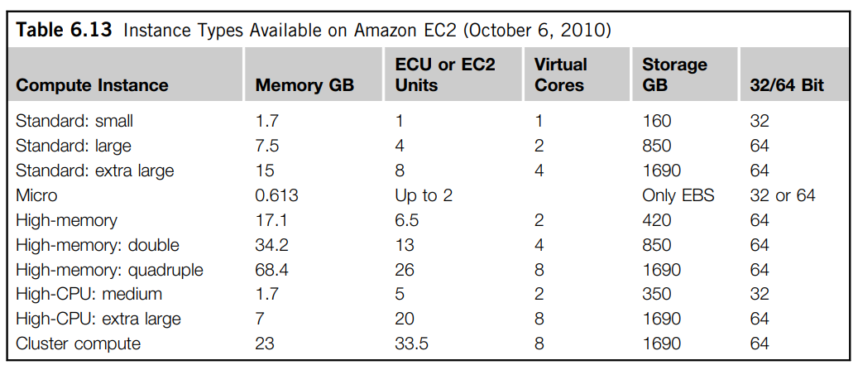

Slide 7
AMAZON SIMPLE STORAGE SERVICE (S3)
Amazon S3 provides a simple web services interface that can be used to store and retrieve any amount of data, at any time, from anywhere on the web.
S3 provides the object-oriented storage service for users.
Users can access their objects through Simple Object Access Protocol (SOAP) with either browsers or other client programs which support SOAP.
SQS is responsible for ensuring a reliable message service between two processes, even if the receiver processes are not running.
Figure 6.24 shows the S3 execution environment.

Slide 8
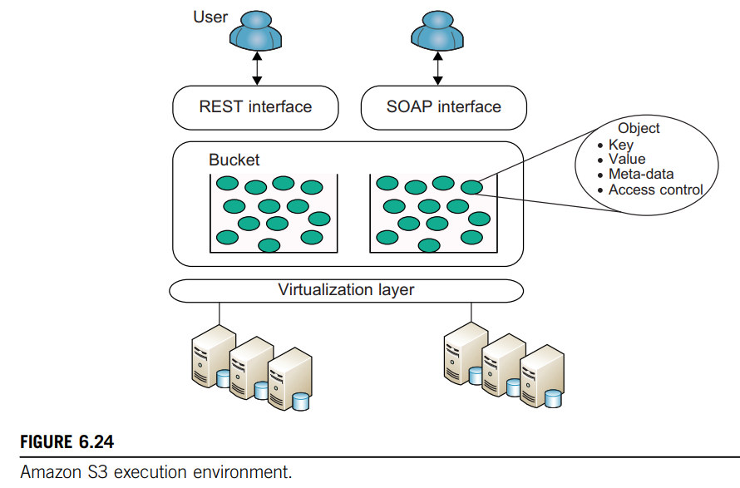

Slide 9
The fundamental operation unit of S3 is called an object.
Each object is stored in a bucket and retrieved via a unique, developer-assigned key.
In other words, the bucket is the container of the object.
Besides unique key attributes, the object has other attributes such as values, metadata, and access control information.
From the programmer’s perspective, the storage provided by S3 can be viewed as a very coarse-grained key-value pair.
Through the key-value programming interface, users can write, read, and delete objects containing from 1 byte to 5 gigabytes of data each.
There are two types of web service interface for the user to access the data stored in Amazon clouds:
REST (web 2.0) interface & SOAP interface.

Slide 10
Some key features of S3:
• Redundant through geographic dispersion.
• Designed to provide 99.999999999% durability & 99.99% availability of objects over a given year with cheaper reduced redundancy storage (RRS).
• Authentication mechanisms to ensure that data is kept secure from unauthorized access. Objects can be made private or public, and rights can be granted to specific users.
• Per-object URLs and ACLs (access control lists).
• Default download protocol of HTTP. A BitTorrent protocol interface is provided to lower costs for high-scale distribution.
• $0.055 (more than 5,000 TB) to 0.15 per GB per month storage (depending on total amount).
• First 1 GB per month input or output free and then $.08 to $0.15 per GB for transfers outside an S3 region.
• There is no data transfer charge for data transferred between Amazon EC2 and Amazon S3 within the same region or for data transferred between the Amazon EC2 Northern Virginia region and the Amazon S3 U.S. Standard region (as of October 6, 2010).

Slide 11
AMAZON ELASTIC BLOCK STORE (EBS) & SIMPLEDB
Elastic Block Store (EBS) - provides volume block interface for saving & restoring the virtual images of EC2 instances.
Traditional EC2 instances will be destroyed after use.
The status of EC2 can now be saved in the EBS system after the machine is shut down.
Users can use EBS to save persistent data and mount to the running instances of EC2.
Note that S3 is “Storage as a Service” with a messaging interface.
EBS is analogous to a distributed file system accessed by traditional OS disk access mechanisms.

Slide 12
EBS allows you to create storage volumes from 1 GB to 1 TB that can be mounted as EC2 instances.
Multiple volumes can be mounted to the same instance.
These storage volumes behave like raw, unformatted block devices, with user-supplied device names and a block device interface.
You can create a file system on top of Amazon EBS volumes, or use them in any other way you would use a block device (like a hard drive).
Snapshots are provided so that the data can be saved incrementally. This can improve performance when saving and restoring data.
In terms of pricing, Amazon provides a similar pay-per-use schema as EC2 and S3. Volume storage charges are based on the amount of storage users allocate until it is released, and is priced at $0.10 per GB/month.

Slide 13
AMAZON SIMPLEDB SERVICE
SimpleDB provides a simplified data model based on the relational database data model.
Structured data from users must be organized into domains.
Each domain can be considered a table.
The items are the rows in the table.
A cell in the table is recognized as the value for a specific attribute (column name) of the corresponding row.
This is similar to a table in a relational database.
However, it is possible to assign multiple values to a single cell in the table.
This is not permitted in a traditional relational database which wants to maintain data consistency.
Many developers simply want to quickly store, access, and query the stored data.
SimpleDB removes the requirement to maintain database schemas with strong consistency.

